Slide 1




Slide 2



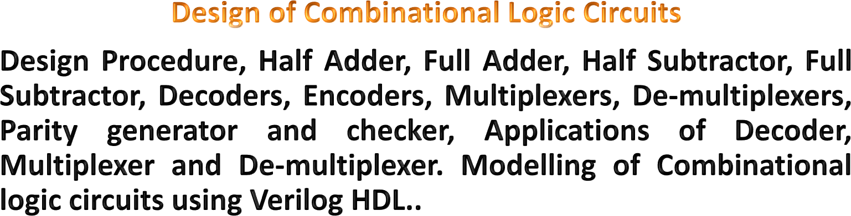



MODULE-3
2

Slide 3



3

Slide 4


INTRODUCTION TO COMBINATIONAL LOGIC
The digital system consists of two types of circuits,
Combinational circuit:
  consists of logic gates
  output at any time is determined from the present combination of inputs.
Sequential circuit:
  comprises both logic gates and the state of storage elements such as flip-flops.
  The output of a sequential circuit depends not only on present value of inputs but also on past state of inputs.
4

Slide 5

INTRODUCTION TO COMBINATIONAL LOGIC
A combinational circuit consists of input variables, logic gates, and output variables.
The logic gates accept signals from inputs and output signals are generated according to the logic circuits employed in it.
Binary information from the given data transforms to desired output data in this process.
Both input and output are obviously the binary signals,
i.e., either logic 1 or logic 0.
6

Slide 6
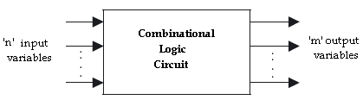

INTRODUCTION TO COMBINATIONAL LOGIC
Block diagram of a combinational logic circuit
7

Slide 7

INTRODUCTION TO COMBINATIONAL LOGIC
For n number of input variables to a combinational circuit, 2^{n} possible combinations of binary input states are possible.
For each possible combination, there is one and only one possible output combination.
A combinational logic circuit can be described by m Boolean functions and each output can be expressed in terms of n input variables.
8

Slide 8



23

Slide 9



DESIGN PROCEDURE
Any combinational circuit can be designed by the
following steps of design procedure.
The problem statement.
Identify the number of input and output variables.
The input and output variables are assign with letter symbols.
Construction of a truth table for the given logic.
The simplified Boolean expression is obtained by any method of minimization—algebraic method, Karnaugh map method.
A logic diagram is realized from the simplified Boolean expression using logic gates.
24

Slide 10

DESIGN PROCEDURE
EXAMPLE-1:
Design a combinational circuits with three input variables
that will produce a logic-1 output when more than one input variables are HIGH state.
Solution:
STEP1: The problem statement.
Design a combinational circuits with three input variables that will produce a logic-1 Output when more than one input variables are HIGH.
STEP2: Identify the input and output variables No. of inputs required: 3
No. of output required: 1
25

Slide 11
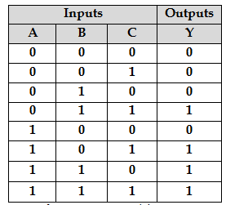

DESIGN PROCEDURE
STEP3: The input & outputs are assign with letter symbols Letter symbol for inputs: A, B, C
Letter symbol for output: Y
STEP4: Construction of a truth table for the given logic
26

Slide 12

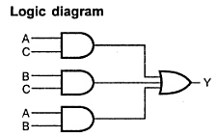

DESIGN PROCEDURE
STEP5: obtain the simplified expression for output variable using K-map simplification
STEP6: A logic
diagram is realized from the simplified Boolean
expression using logic gates
C
0 1
AB
00
01
11
0 |  | 0
0 |  | 1
 | 1 | 1
0 |  | 1
10
Y = (AB)+(AC)+(BC)
27

Slide 13


DESIGN PROCEDURE
EXERCISES
Design a circuit with 4 inputs that has outputs with a
binary value equal to the number of inputs that are HIGH.
A logic circuit accepts two 3-bit numbers and generates a logic output only when the two 3-bit numbers applied to the circuit are equal. Design the logic circuit.
Design a logic circuit that will produce a 1 only when the number of 1’s in a set of four inputs variables, A, B, and C, D are even (i.e. an even parity checker).
31

Slide 14



32

Slide 15






BINARY ADDER
HALF ADDER
A half-adder is a combinational circuit that can be used
to add two binary bits.
It has two inputs that represent the two bits to be added and two outputs, with one producing the SUM output and the other producing the CARRY.
Inputs |  | Outputs
A | B | Carry (C) | Sum (S)
0 | 0 | 0 | 0
0 | 1 | 0 | 1
1 | 0 | 0 | 1
1 | 1 | 1 | 0
BLOCK DIAGRAM
TRUTH TABLE
33

Slide 16

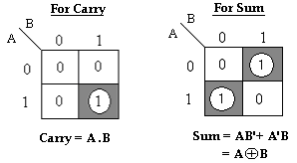


BINARY ADDER
HALF ADDER
The Boolean expressions for the SUM and CARRY outputs are given by the equations,
Sum, S = A’B+ AB’= A⊕B
Carry, C = A . B
34

Slide 17
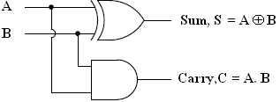

BINARY ADDER
HALF ADDER
The first one representing the SUM output is that of an EX-OR gate, the second one representing the CARRY output is that of an AND gate.
LOGIC DIAGRAM
35

Slide 18

BINARY ADDER
FULL ADDER
The full adder circuit overcomes the limitation of the half-adder, which can be used to add two bits only.
A full adder is a combinational circuit that forms the arithmetic sum of three input bits.
It consists of 3 inputs and 2 outputs. Two of the input variables, represent the significant bits to be added.
The third input represents carry from previous lower significant position.
36

Slide 19

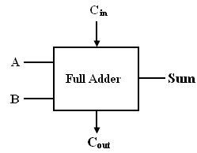

BINARY ADDER
FULL ADDER
Inputs |  |  | Outputs
A | B | ^{C}in | Sum (S) | Carry (C_{out})
0 | 0 | 0 | 0 | 0
0 | 0 | 1 | 1 | 0
0 | 1 | 0 | 1 | 0
0 | 1 | 1 | 0 | 1
1 | 0 | 0 | 1 | 0
1 | 0 | 1 | 0 | 1
1 | 1 | 0 | 0 | 1
1 | 1 | 1 | 1 | 1
LOGIC DIAGRAM
TRUTH TABLE
37

Slide 20
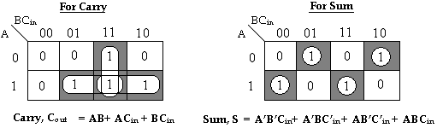

BINARY ADDER
FULL ADDER
K-MAP
The Boolean expressions for the SUM and CARRY outputs are given by the equations,
Sum, S= A’B’C_{in}+ A’BC’_{in} + AB’C’_{in} + ABC_{in}
Carry, C_{out} = AB+ AC_{in} + BC_{in .}
38

Slide 21
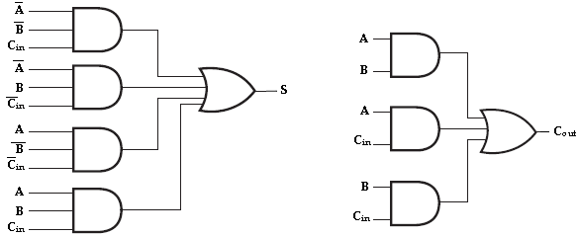

BINARY ADDER
FULL ADDER
The logic diagram for the above functions is shown as,
Implementation of full-adder in Sum of Products
39

Slide 22

BINARY ADDER
FULL ADDER
The logic diagram of the full adder can also be implemented with two half-adders and one OR gate.
The S output from the second half adder is the exclusive- OR of C_{in} and the output of the first half-adder, giving
Sum = A’BC’_{in} + AB’C’_{in} + ABC_{in} + A’B’C_{in .}
= C’_{in} (A’B+AB’) + C_{in} (AB+A’B’)
= C’_{in} (A’B+AB’) + C_{in} (A’B+AB’)’
= C_{in} ⊕ (A’B+AB’)
= C_{in} ⊕ (A ⊕ B) [x ⊕ y = x’y+ xy’]
40

Slide 23


BINARY ADDER
FULL ADDER
Carry, C_{out} = AB+ AC_{in}+ BC_{in.}
= AB+ AC_{in}+ BC_{in} (A +A’)
= ABC_{in}+ AB+ AC_{in}+ A’BC_{in}
= AB (C_{in}+1) + AC_{in}+ A’BC_{in}
= AB+ AC_{in}+ A’BC_{in}
= AB+ AC_{in} (B+B’) + A’BC_{in}
= ABC_{in}+ AB+ A’BC_{in}+ AB’C_{in}
= AB (C_{in}+1) + A’BC_{in}+ AB’C_{in}
= AB+ A’BC_{in}+ AB’C_{in}
= AB+ C_{in} (A’B+AB’)
[C_{in}+1= 1]
[C_{in}+1= 1]
41

Slide 24
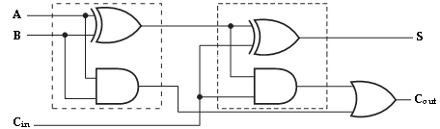

BINARY ADDER
FULL ADDER
Implementation of full adder with two half-adders and an OR gate
42

Slide 25


43

Slide 26



BINARY SUBTRACTOR
HALF SUBTRACTOR
A half Subtractor is a combinational circuit that can be used to subtract one binary digit from another to produce a DIFFERENCE output and a BORROW output.
The BORROW output here specifies whether a ‘1’ has been borrowed to perform the subtraction.
Block schematic of half Subtractor
44

Slide 27


BINARY SUBTRACTOR
HALF SUBTRACTOR
The truth table of half Subtractor, showing all possible input combinations and the corresponding outputs are shown below.
Input |  | Output
A | B | Difference (D) | Borrow (B_{out})
0 | 0 | 0 | 0
0 | 1 | 1 | 1
1 | 0 | 1 | 0
1 | 1 | 0 | 0
45

Slide 28
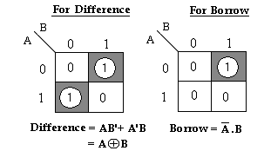

BINARY SUBTRACTOR
HALF SUBTRACTOR
K-map simplification for half Subtractor:
The Boolean expressions for the DIFFERENCE and BORROW outputs are given by the equations,
Difference, D= A’B+ AB’= A ⊕ B Borrow, B_{out} = A’ . B
46

Slide 29
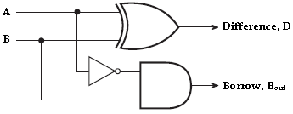

BINARY SUBTRACTOR
HALF SUBTRACTOR
Logic Implementation of Half-Subtractor
47

Slide 30

BINARY SUBTRACTOR
HALF SUBTRACTOR
Comparing a half Subtractor with a half-adder, we find that the expressions for the SUM and DIFFERENCE outputs are just the same.
The expression for BORROW in the case of the half- Subtractor is also similar to what we have for CARRY in the case of the half-adder.
If the input A i.e. the minuend is complemented, an AND gate can be used to implement the BORROW output.
48

Slide 31

BINARY SUBTRACTOR
FULL SUBTRACTOR
A full Subtractor performs subtraction operation on two bits, a minuend and a subtrahend, and also takes into consideration whether a ‘1’ has already been borrowed by the previous adjacent lower minuend bit or not.
As a result, there are three bits to be handled at the input of a full Subtractor, namely the two bits to be subtracted and a borrow bit designated as B_{in}.
49

Slide 32
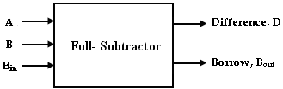

BINARY SUBTRACTOR
FULL SUBTRACTOR
There are two outputs, namely the DIFFERENCE output D and the BORROW output B_{o}. The BORROW output bit tells whether the minuend bit needs to borrow a ‘1’ from the next possible higher minuend bit.
Block schematic of full Subtractor
50

Slide 33



BINARY SUBTRACTOR
FULL SUBTRACTOR
Inputs |  |  | Outputs
A | B | ^{B}in | Difference(D) | Borrow(B_{out})
0 | 0 | 0 | 0 | 0
0 | 0 | 1 | 1 | 1
0 | 1 | 0 | 1 | 1
0 | 1 | 1 | 0 | 1
1 | 0 | 0 | 1 | 0
1 | 0 | 1 | 0 | 0
1 | 1 | 0 | 0 | 0
1 | 1 | 1 | 1 | 1
Truth Table
51

Slide 34
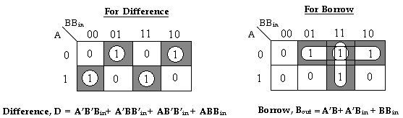

BINARY SUBTRACTOR
FULL SUBTRACTOR
K-map simplification for full Subtractor:
The Boolean expressions for the DIFFERENCE and BORROW outputs are given by the equations,
Difference, D= A’B’B_{in}+ A’BB’_{in} + AB’B’_{in} + ABB_{in} Borrow, B_{out} = A’B+ A’C_{in} + BB_{in .}
52

Slide 35
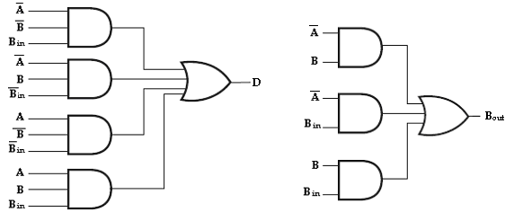


BINARY SUBTRACTOR
FULL SUBTRACTOR
Implementation of full Subtractor
53

Slide 36

BINARY SUBTRACTOR
FULL SUBTRACTOR
The logic diagram of the full Subtractor can also be implemented with two half Subtractor and one OR gate.
The difference, D output from the second half Subtractor is the exclusive-OR of B_{in} and the output of the first half Subtractor, giving
Difference, D = A’BB’_{in} + AB’B’_{in} + ABB_{in} + A’B’B_{in .}
= B’_{in} (A’B+AB’) + B_{in} (AB+A’B’)
= B’_{in} (A’B+AB’) + B_{in} (A’B+AB’)’
= B_{in} ⊕ (A’B+AB’)
= B_{in} ⊕ (A ⊕ B)
[(x’y+xy’)’= (xy+x’y’)]
[x ⊕ y = x’y+ xy’]
54

Slide 37

BINARY SUBTRACTOR
FULL SUBTRACTOR
= A’B+ BB_{in}+ A’B_{in.}
= A’B+ BB_{in}+ A’B_{in} (B +B’)
= A’BB_{in}+ A’B+ BB_{in}+ A’B’B_{in}
= A’B (B_{in}+1) + BB_{in}+ A’B’B_{in}
= A’B+ BB_{in}+ A’B’B_{in}
= A’B+ BB_{in} (A+A’) + A’B’B_{in}
= A’BB_{in}+ A’B+ ABB_{in}+ A’B’B_{in}
= A’B (B_{in}+1) + ABB_{in}+ A’B’B_{in}
= A’B+ ABB_{in}+ A’B’B_{in}
= A’B+ B_{in} (AB+A’B’)
Borrow, B_{out}
[B_{in}+1= 1]
[A+A’= 1]
[B_{in}+1= 1]
= A’B+ B_{in} (A’B+AB’)’ [(x’y+xy’)’=(xy+x’y’)]
55

Slide 38
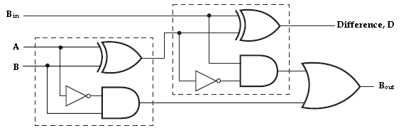

BINARY SUBTRACTOR
FULL SUBTRACTOR
Therefore, we can implement full Subtractor using two half Subtractor and OR gate as,
Implementation of full Subtractor with two half Subtractor and an OR gate
56

Slide 39

BINARY ADDER & SUBTRACTOR
APPLICATIONS
Adders & Subtractors are wildly used in in computer’s ALU (Arithmetic logic unit) to compute addition as well as CPU (Central Processing unit) and GPU (Graphics Processing unit) for graphics applications to reduce the circuit complexity.
Adder and subtractor are basically used for performing arithmetical functions like addition, subtraction, multiplication and division in electronic calculators and digital instruments.
56

Slide 40

BINARY ADDER & SUBTRACTOR
APPLICATIONS
Microcontrollers use adders for arithmetic additions, PC (program counter) and timers.
It is also used in microprocessors to calculate address, table indices, increment and decrement operators and slimier operations
It is also used in networking and DSP (Digital signal processor) oriented system
56

Slide 41



57

Slide 42


PARALLEL ADDER
A single full adder is capable of adding two one bit numbers and an input carry. In order to add a binary number with more than one bit an additional full adders must be employed.
The n-bit parallel adder can be constructed using “n”
number of full adder circuits in parallel.
The block diagram of n-bit parallel adder using number of full adder circuits connected in cascade i.e. the carry output of each adder is connected to the carry input of the next higher order adder is shown in figure.
58

Slide 43
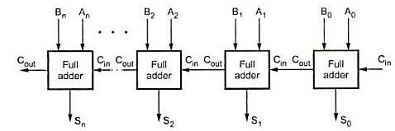

PARALLEL ADDER
n-bit parallel Adder
59

Slide 44
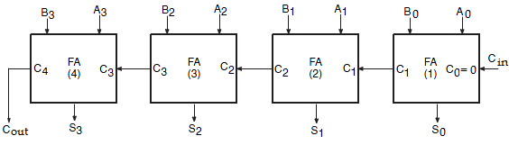

PARALLEL ADDER
The 4-bit binary adder using full adder circuits is capable of adding two 4-bit numbers resulting in a 4-bit sum and a carry output as shown in figure below.
4-bit binary parallel Adder
60

Slide 45
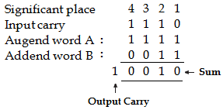

PARALLEL ADDER
Since all the bits of augend and addend are fed into the adder circuits simultaneously and the additions in each position are taking place at the same time, this circuit is known as parallel adder.
Let the 4-bit words to be added be represented by, A₃ A₂ A₁ A₀= 1 1 1 1 and B₃ B₂ B₁ B₀= 0 0 1 1.
61

Slide 46
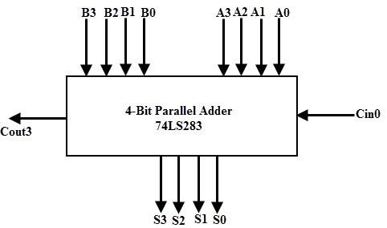

PARALLEL ADDER
Logic diagram of 4-bit parallel adder
62

Slide 47


PARALLEL ADDER
The bits are added with full adders, starting from the least significant position, to form the sum bit and carry bit.
The input carry C₀ in the least significant position must be 0. The carry output of the lower order stage is connected to the carry input of the next higher order stage.
Hence this type of adder is called ripple-carry adder.
63

Slide 48

PARALLEL ADDER
In the least significant stage, A₀, B₀ and C₀ (which is 0) are added resulting in sum S₀ and carry C₁. This carry C₁ becomes the carry input to the second stage.
Similarly in the second stage, A₁, B₁ and C₁ are added resulting in sum S₁ and carry C_{2,} in the third stage, A₂, B₂ and C₂ are added resulting in sum S₂ and carry C_{3,} in the third stage, A₃, B₃ and C₃ are added resulting in sum S₃ and C_{4,} which is the output carry.
Thus the circuit results in a sum (S₃ S₂ S₁ S₀) and a carry output (C_{out}).
64

Slide 49


MODULE-3

Slide 50


DECODERS
A decoder is a combinational circuit that converts binary information from ‘n’ input lines to a maximum of ‘2^{n}’ unique output lines.
The encoded information is presented as ‘n’ inputs producing ‘2^{n}’ possible outputs. The 2^{n} output values are from 0 through 2^{n}-1.
A decoder is provided with enable inputs to activate decoded output based on data inputs. When any one enable input is unasserted, all outputs of decoder are disabled.
MODULE-3

Slide 51
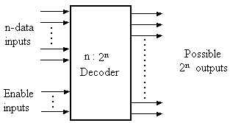

DECODERS
Block diagram of decoders
MODULE-3

Slide 52

DECODERS
2 : 4 Decoders
A binary decoder is used when it is necessary to activate exactly one of 2^{n} outputs based on an n-bit input value.
Here the 2 inputs are decoded into 4 outputs, each output representing one of the minterms of the two input variables.
As shown in the truth table, if enable input is 1 (EN= 1) only one of the outputs (Y₀ – Y₃), is active for a given input.
MODULE-3

Slide 53



DECODERS
2 : 4 Decoders
Inputs |  |  | Outputs
Enable | A | B | Y₃ | Y₂ | Y₁ | Y₀
0 | x | x | 0 | 0 | 0 | 0
1 | 0 | 0 | 0 | 0 | 0 | 1
1 | 0 | 1 | 0 | 0 | 1 | 0
1 | 1 | 0 | 0 | 1 | 0 | 0
1 | 1 | 1 | 1 | 0 | 0 | 0
Truth table
MODULE-3

Slide 54
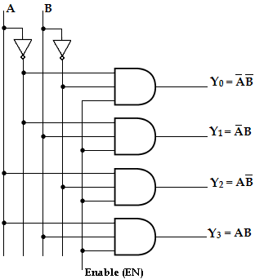

DECODERS
2 : 4 Decoders
Logic Diagram
MODULE-3

Slide 55

DECODERS
3 : 8 Decoders
A 3-to-8 line decoder has three inputs (A, B, C) and eight outputs (Y₀- Y₇). Based on the 3 inputs one of the eight outputs is selected.
This decoder is used for binary-to-octal conversion. The input variables may represent a binary number and the outputs will represent the eight digits in the octal number system.
The output line whose value is equal to 1 represents the minterm equivalent of the binary number presently available in the input lines.
MODULE-3

Slide 56


DECODERS
3 : 8 Decoders
Inputs |  |  | Outputs
A | B | C | Y₀ | Y₁ | Y₂ | Y₃ | Y₄ | Y₅ | Y₆ | Y₇
0 | 0 | 0 | 1 | 0 | 0 | 0 | 0 | 0 | 0 | 0
0 | 0 | 1 | 0 | 1 | 0 | 0 | 0 | 0 | 0 | 0
0 | 1 | 0 | 0 | 0 | 1 | 0 | 0 | 0 | 0 | 0
0 | 1 | 1 | 0 | 0 | 0 | 1 | 0 | 0 | 0 | 0
1 | 0 | 0 | 0 | 0 | 0 | 0 | 1 | 0 | 0 | 0
1 | 0 | 1 | 0 | 0 | 0 | 0 | 0 | 1 | 0 | 0
1 | 1 | 0 | 0 | 0 | 0 | 0 | 0 | 0 | 1 | 0
1 | 1 | 1 | 0 | 0 | 0 | 0 | 0 | 0 | 0 | 1
Truth table
MODULE-3

Slide 57
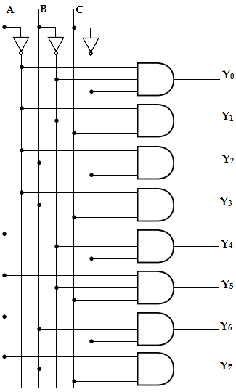

DECODERS
3 : 8 Decoders
Logic Diagram
MODULE-3

Slide 58

DECODERS
Applications
Instruction decoder is the part of the CPU
Memory address decoding
Decoder outputs can be display (TTL 74LS47)
used to drive a 7 segment
Binary Decoders such as binary or BCD ,decimal or octal etc and commonly available decoder IC’s (TTL 74LS138 3-to-8 line binary decoder or the 74ALS154 4-to-16 line decoder)
MODULE-3

Slide 59

DECODERS
Cascading Decoders
Design a 4 to 16 line decoders using 2 to 4 line
Example: decoders
To implement 4:16 decoder we need five 2:4 line decoders.
Decoder-1 is used to enable one of the decoder 2, 3, 4 and 5. Inputs of
the first decoders are A and B i.e. MSB inputs of 4:16 decoders.
The inputs of decoders are connected together forming C and D inputs of 4:16 decoders.
When AB=00 decoder-1 is enabled, for AB=01 decoder-2 is enabled, for AB=10 decoder-3 is selected, and for AB=11 decoder-4 is enabled.
MODULE-3

Slide 60
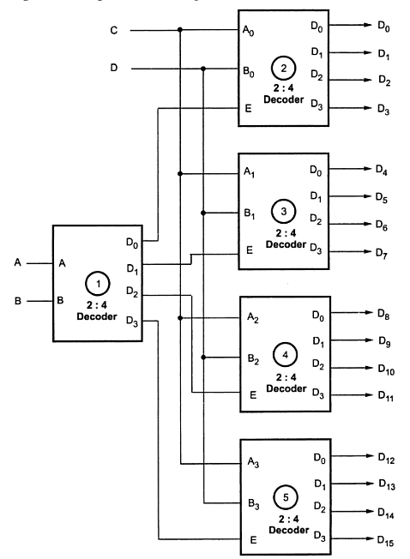

DECODERS
Cascading Decoders
MODULE-3

Slide 61

DECODERS
Realization of Boolean Expression using Decoders
The combination of decoder and external logic gates can be used to implement single or multiple output function. The decoder can have one of the two output states either active or active high.
For active high output :
SOP function implementation
  When the decoder output is active high it generates minterms for input variables (i.e) it makes the selected output logic1. In such cases to implement the sop function we have to take sum of selected product terms generated by decoder. This can be implemented by ORing the selected decoder output.
MODULE-3

Slide 62
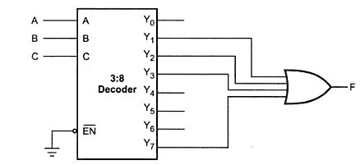

DECODERS
Realization of Boolean Expression using Decoders
MODULE-3

Slide 63
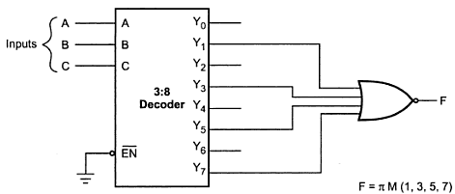

DECODERS
Realization of Boolean Expression using Decoders
POS function implementation: When the decoder output is active high POS function in similar manner as per SOP function except function output is complemented. This can be achieved by connecting NOR gates instead of OR gates .
Single output function implementation using decoder and gate
MODULE-3

Slide 64



MODULE-3

Slide 65

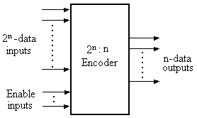

ENCODERS
An encoder is a combinational circuit that converts binary information from 2^{n} input lines to a maximum of ‘n’ unique output lines.
An encoder is a digital circuit that performs the inverse
operation of a decoder. Hence, decoding process is called
of the encoding. The general
the opposite
structure of encoder circuit is,
MODULE-3

Slide 66

ENCODERS
Generally, digital encoders produce outputs of 2-bit, 3-bit or 4-bit codes depending upon the number of data input lines.
An "n-bit" binary encoder has 2^{n} input lines and n-bit output lines with common types that include 4-to-2, 8-to- 3 and 16-to-4 line configurations.
The output lines of a digital encoder generate the binary equivalent of the input line whose value is equal to “1”.
MODULE-3

Slide 67
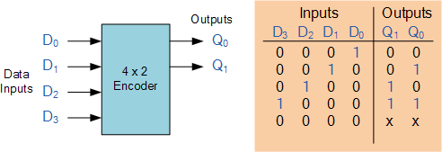
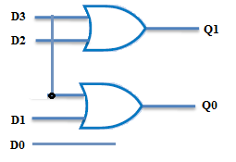

ENCODERS
4 to 2 Encoder
MODULE-3

Slide 68

ENCODERS
Priority Encoder
One of the main disadvantages of standard digital encoders is that they can generate the wrong output code when there is more than one input present at logic level "1".
For example, if we make inputs D₁ and D₂ HIGH at logic "1" both at the same time, the resulting output is neither at "01" or at "10" but it will be at "11" which is an output binary number that is different to the actual input present.
MODULE-3

Slide 69
ENCODERS
Priority Encoder
One simple way to overcome this problem is to "Priorities" the level of each input pin and if there was more than one input at logic level "1" the actual output code would only correspond to the input with the highest designated priority.
Then this type of digital encoder is known commonly as a Priority Encoder or P-encoder for short.
MODULE-3
205

Slide 70

ENCODERS
Priority Encoder
A priority encoder is an encoder circuit that includes the
priority function.
In priority encoder, if two or more inputs are equal to 1 at the same time, the input having the highest priority will take precedence. The higher the subscript number, higher the priority of the input.
Input D₃, has the highest priority. So, regardless of the values of the other inputs, when D₃ is 1, the output for xy is 11. D₂ has the next priority level. The output is 10, if D₂= 1 provided D₃= 0. The output for D₁ is generated only if higher priority inputs are 0, and so on down the priority levels.
MODULE-3

Slide 71
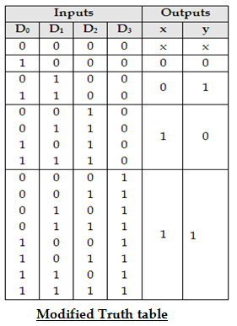
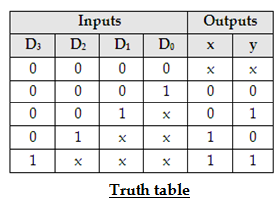

ENCODERS
4 to 2 Priority Encoder
MODULE-3

Slide 72
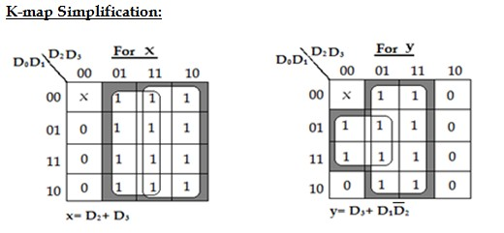

ENCODERS
4 to 2 Priority Encoder
MODULE-3

Slide 73
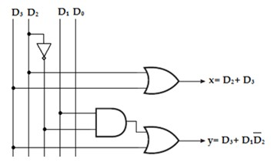

ENCODERS
4 to 2 Priority Encoder
4-Input Priority Encoder
MODULE-3

Slide 74
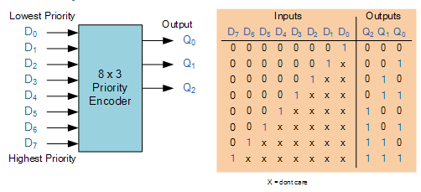

ENCODERS
8 to 3 Priority Encoder
MODULE-3

Slide 75


ENCODERS
Encoder Applications
(i). Keyboard Encoder
Priority encoders can be used to reduce the number of wires needed in a particular circuits or application that have multiple inputs.
For example, assume that a microcomputer needs to read the 104 keys of a standard QWERTY keyboard where only one key would be pressed either “HIGH” or “LOW” at any one time.
One way would be to connect all 104 wires from the individual keys on the keyboard directly to the computers input but this would be impractical for a small home PC.
MODULE-3

Slide 76

ENCODERS
Encoder Applications
Another alternative and better way would be to interface the keyboard to the PC using a priority encoder.
The 104 individual buttons or keys could be encoded into a standard ASCII code of only 7-bits (0 to 127 decimal) to represent each key or character of the keyboard and then input as a much smaller 7-bit B.C.D code directly to the computer.
Keypad encoders such as the 74C923 20-key encoder are available to do just that.
MODULE-3

Slide 77

ENCODERS
Encoder Applications
(ii) Positional Encoders
Another more common application is in magnetic positional
control as used on ships navigation or for robotic arm
positioning etc.
Here for example, the angular or rotary position of a compass is converted into a digital code by a 74LS148 8-to-3 line
priority encoder and input to the systems computer to provide navigational data and an example of a simple 8 position to 3-bit output compass encoder is shown below.
Magnets and reed switches could be used at each compass point to indicate the needles angular position.
MODULE-3

Slide 78
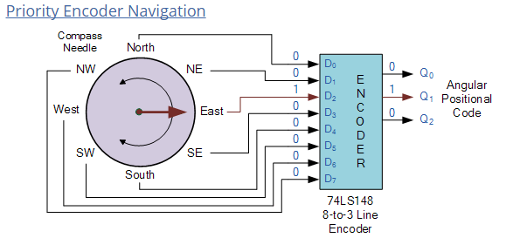

ENCODERS
Encoder Applications
MODULE-3

Slide 79
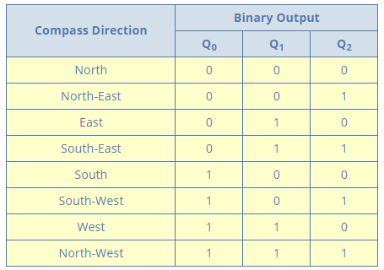

ENCODERS
Encoder Applications
MODULE-3

Slide 80

ENCODERS
Encoder Applications
(iii). Interrupt Requests
Priority Encoders used microprocessor applications.
for detecting interrupts in
Here the microprocessor uses interrupts to allow peripheral devices such as the disk drive, scanner, mouse, or printer etc, to communicate with it.
But the microprocessor can only “talk” to one peripheral device at a time so needs some way of knowing when a particular peripheral device wants to communicate with it.
MODULE-3

Slide 81

ENCODERS
Encoder Applications
The processor does this by using “Interrupt Requests” or
“IRQ” signals to assign priority to all the peripheral devices to ensure that the most important peripheral device is serviced first.
The order of importance of the devices will depend upon their connection to the priority encoder.
Because implementing such a system using priority encoders such as the standard 74LS148 priority encoder IC involves additional logic circuits, purpose built integrated circuits such as the 8259 Programmable Priority Interrupt Controller is available.
MODULE-3

Slide 82
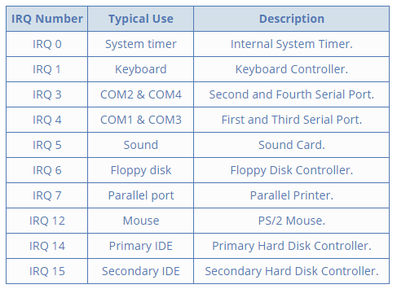

ENCODERS
Encoder Applications
MODULE-3

Slide 83


79

Slide 84


BINARY MULTIPLIER
Multiplication of binary numbers is performed in the same way as in decimal numbers.
The multiplicand is multiplied by each bit of the multiplier starting from the least significant bit.
Each such multiplication forms a partial product. Such partial products are shifted one position to left.
The final product is obtained from the sum of partial products.
80

Slide 85

BINARY MULTIPLIER
2-Bit by 2-Bit Multiplier
Consider the multiplication of two 2-bit numbers. The multiplicand bits are B₁ and B₀, the multiplier bits are A₁ and A₀, and the product is P₃, P₂, P₁ and P₀.
The first partial product is formed by multiplying B₀ by A₁A₀. The multiplication of two bits such as A₀ and B₀ produces a 1 if both bits are 1; otherwise, it produces a 0.
This is identical to an AND operation. Therefore the partial product can be implemented with AND gates as shown in the diagram.
81

Slide 86
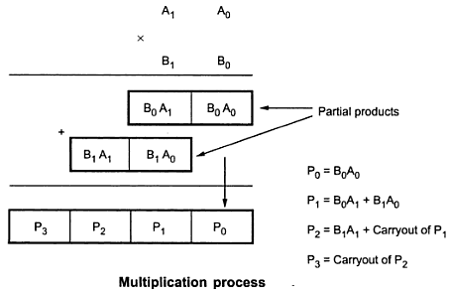

BINARY MULTIPLIER
2-Bit by 2-Bit Multiplier
The second partial product is formed by multiplying A₁ by B₁B₀ and shifted one position to the left. The two partial products are added with two half adder (HA) circuits.
82

Slide 87
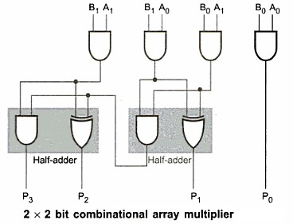

BINARY MULTIPLIER
2-Bit by 2-Bit Multiplier
83

Slide 88


BINARY MULTIPLIER
2-Bit by 2-Bit Multiplier
Usually there are more bits in the partial products and it is necessary to use full adders to produce the sum of the partial products.
The least significant bit of the product does not have to go through an adder since it is formed by the output of the first AND gate.
A combinational circuit binary multiplier with more bits can be constructed in a similar fashion. A bit of the multiplier is ANDed with each bit of the multiplicand in as many levels as there are bits in the multiplier.
84

Slide 89

BINARY MULTIPLIER
4-Bit by 4-Bit Multiplier
The binary output in each level of AND gates are added with the partial product of the previous level to form a new partial product. The last level produces the final product result.
Consider a multiplier circuit that multiplies a binary number of four bits by a number of four bits.
Let the multiplicand be represented by B₃, B₂, B₁, B₀ and the multiplier by A₃, A₂, A₁, and A₀.
85

Slide 90

BINARY MULTIPLIER
4-Bit by 4-Bit Multiplier
Since 4x4 multiplication process we need 16 AND gates and three 4-bit parallel adders to produce a product of eight bits.
As shown in figure each shifted multiplicand which is multiplied by either 0 or 1 depending on the corresponding, multiplier bit is called partial product.
The final 8-bit product is obtained by adding all partial products.
86

Slide 91
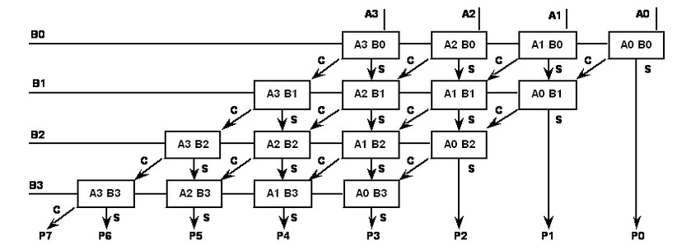

BINARY MULTIPLIER
4-Bit by 4-Bit Multiplier
87

Slide 92

BINARY MULTIPLIER
4-Bit by 4-Bit Multiplier
The multiplication of B₀ and A₀ produces a 1 if both bits are 1; otherwise it produces 0. This is identical to AND gates operation. Therefore the partial products can be implemented with AND gates.
The 4-bit partial products are added using 4-bit parallel adder. During addition of first partial product three most significant bits of it are added to the second partial product.
As we take only three bits from the partial product, the fourth bit (MSB) is considered as 0.
88

Slide 93

BINARY MULTIPLIER
4-Bit by 4-Bit Multiplier
The three most significant bits and carry out of first partial sum are then added to the third partial product.
Finally the three most significant bits and carry out of second partial sum are added to the fourth partial product the carryout and third sum represents the five most significant bits of the product.
Least significant bits of first and second partial sum represent P₁ and P₂ respectively & product B₀A₀ represents P₀.
89

Slide 94
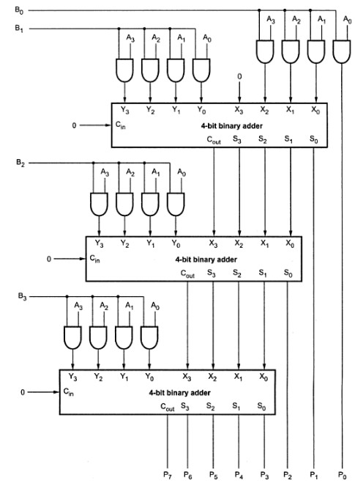

BINARY MULTIPLIER
4-Bit by 4-Bit Multiplier
90

Slide 95




Slide 96



MAGNITUDE COMPARATOR
A magnitude comparator is a combinational circuit that compares two given numbers (A and B) and determines whether one is equal to, less than or greater than the other.
The output is in the form of three binary variables representing the conditions A = B, A>B and A<B, if A and B are the two numbers being compared.
Block diagram of magnitude comparator

Slide 97

MAGNITUDE COMPARATOR
2-Bit Magnitude Comparator
Inputs |  |  |  | Outputs
A₁ | A₀ | B₁ | B₀ | A>B | A=B | A<B
0 | 0 | 0 | 0 | 0 | 1 | 0
0 | 0 | 0 | 1 | 0 | 0 | 1
0 | 0 | 1 | 0 | 0 | 0 | 1
0 | 0 | 1 | 1 | 0 | 0 | 1
0 | 1 | 0 | 0 | 1 | 0 | 0
0 | 1 | 0 | 1 | 0 | 1 | 0
0 | 1 | 1 | 0 | 0 | 0 | 1
0 | 1 | 1 | 1 | 0 | 0 | 1
1 | 0 | 0 | 0 | 1 | 0 | 0
1 | 0 | 0 | 1 | 1 | 0 | 0
1 | 0 | 1 | 0 | 0 | 1 | 0
1 | 0 | 1 | 1 | 0 | 0 | 1
1 | 1 | 0 | 0 | 1 | 0 | 0
1 | 1 | 0 | 1 | 1 | 0 | 0
1 | 1 | 1 | 0 | 1 | 0 | 0
1 | 1 | 1 | 1 | 0 | 1 | 0
Truth Table

Slide 98
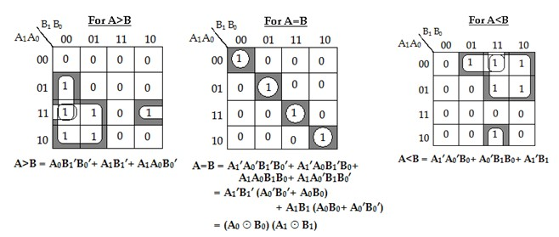

MAGNITUDE COMPARATOR
2-Bit Magnitude Comparator
K-Map Simplification

Slide 99
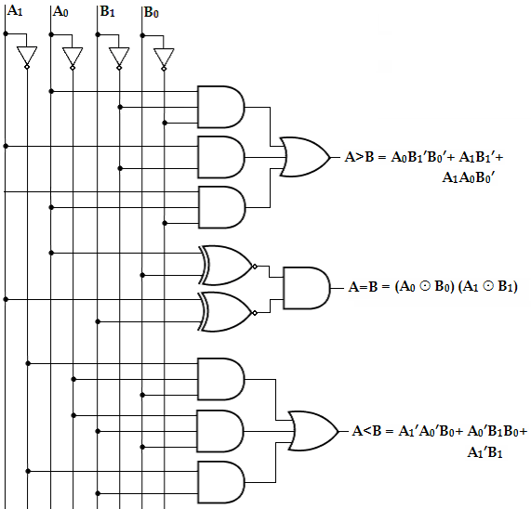

MAGNITUDE COMPARATOR
2-Bit Magnitude Comparator
Logic Diagram
BECE102L – DIGITAL SYSTEM DESIGN

Slide 100


MAGNITUDE COMPARATOR
4-Bit Magnitude Comparator
Let us consider the two binary numbers A and B with four digits each. Write the coefficient of the numbers in descending order as,
A = A₃A₂A₁A₀ B = B₃ B₂ B₁ B₀
Each subscripted letter represents one of the digits in the number. It is observed from the bit contents of two numbers that A = B when A₃ = B₃, A₂ = B₂, A₁ = B₁ and
A₀ = B₀.
MODULE- 3

Slide 101

MAGNITUDE COMPARATOR
4-Bit Magnitude Comparator
When the numbers are binary they possess the value of either 1 or 0, the equality relation of each pair can be expressed logically by the equivalence function as
Xi = Ai Bi + Ai ′ Bi ′
Xi = (A ⊕ B)′
Xi = (Ai Bi ′ + Ai ′Bi )′
for i = 0, 1, 2, 3 Or, Xi ′ = A ⊕ B
Or,
Or,
where, Xi =1 only if the pair of bits in position i are equal (i.e., if both are 1 or both are 0).
132

Slide 102

MAGNITUDE COMPARATOR
4-Bit Magnitude Comparator
To satisfy the equality condition of two numbers A and B, it is necessary that all Xi must be equal to logic 1. This indicates the AND operation of all Xi variables.
In other words, we can write the Boolean expression for two equal 4-bit numbers.
(A = B) = X₃X₂X₁ X₀. (where X = A xnor B)
The binary variable (A=B) is equal to 1 only if all pairs of digits of the two numbers are equal.

Slide 103

MAGNITUDE COMPARATOR
4-Bit Magnitude Comparator
To determine if A is greater than or less than B, we inspect the relative magnitudes of pairs of significant bits starting from the most significant bit.
If the two digits of the most significant position are equal, the next significant pair of digits is compared. The comparison process is continued until a pair of unequal digits is found.
It may be concluded that A>B, if the corresponding digit of A is 1 and B is 0. If the corresponding digit of A is 0 and B is 1, we conclude that A<B.

Slide 104

MAGNITUDE COMPARATOR
4-Bit Magnitude Comparator
In a 4-bit comparator the condition of A>B can be possible in the following four cases:
  If A3 = 1 and B3 = 0
  If A3 = B3 and A2 = 1 and B2 = 0
  If A3 = B3, A2 = B2 and A1 = 1 and B1 = 0
4. If A3 = B3, A2 = B2, A1 = B1 and A0 = 1 and B0 = 0
Similarly the condition for A<B can be possible in the following four cases:
  If A3 = 0 and B3 = 1
  If A3 = B3 and A2 = 0 and B2 = 1
  If A3 = B3, A2 = B2 and A1 = 0 and B1 = 1
4. If A3 = B3, A2 = B2, A1 = B1 and A0 = 0 and B0 = 1
134

Slide 105
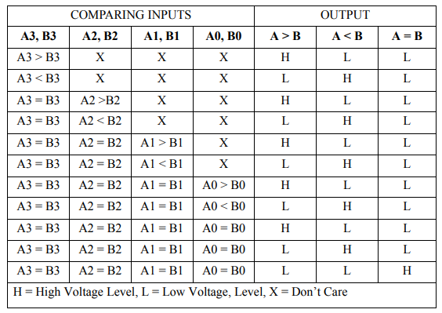
MAGNITUDE COMPARATOR
4-Bit Magnitude Comparator
134

Slide 106


MAGNITUDE COMPARATOR
4-Bit Magnitude Comparator
Therefore, we can derive the logical expression of such
sequential comparison by,
(A>B) = A₃B₃′ +X₃A₂B₂′ +X₃X₂A₁B₁′ +X₃X₂X₁A₀B₀′ (A<B) = A₃′B₃ +X₃A₂′B₂ +X₃X₂A₁′B₁ +X₃X₂X₁A₀′B₀
The symbols (A>B) and (A<B) are binary output variables that are equal to 1 when A>B or A<B, respectively.
The gate implementation of the three output variables just derived is simpler than it seems because it involves a certain amount of repetition.
The unequal outputs can use the same gates that are needed to generate the equal output.

Slide 107
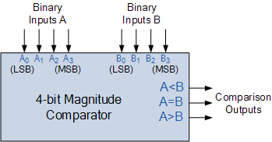

MAGNITUDE COMPARATOR
Block diagram of 4-Bit magnitude comparator (IC7485)
136

Slide 108
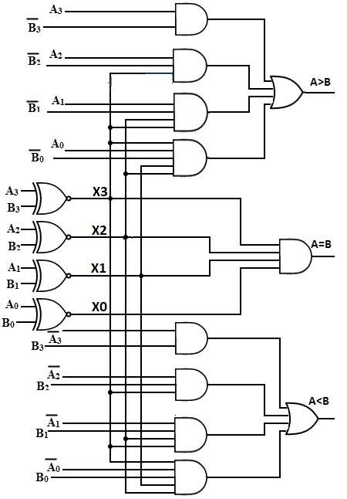
MAGNITUDE COMPARATOR
Logic diagram of 4-Bit
magnitude comparator
136

Slide 109
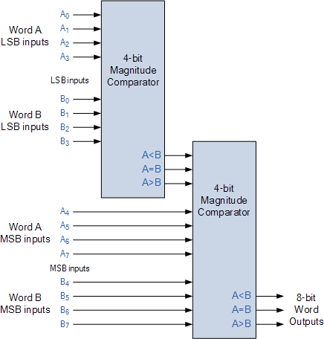
MAGNITUDE COMPARATOR
Block diagram of 8-Bit
magnitude comparator
136

Slide 110
MAGNITUDE COMPARATOR
Applications of Magnitude Comparator
Comparators are used in central processing units (CPUs) and microcontrollers (ALU).
These are used in control applications in which the binary numbers representing physical variables such as temperature, position, etc. are compared with a reference value.
Comparators are also used as process controllers and for Servo motor control.
Analogue-to-Digital converters, (ADC)
133

Slide 111




Slide 112


PARITY GENERATOR
A Parity is a very useful tool in information processing in digital computers to indicate any presence of error in bit information.
External noise and loss of signal strength causes loss of data bit information while transporting data from one device to other device, located inside the computer or externally.
To indicate any occurrence of error, an extra bit is included with the message according to the total number of 1s in a set of data, which is called parity.

Slide 113


PARITY GENERATOR
If the extra bit is considered 0 if the total number of 1s is even and 1 for odd quantities of 1s in a set of data, then it is called even parity.
On the other hand, if the extra bit is 1 for even quantities of 1s and 0 for an odd number of 1s, then it is called odd parity.

Slide 114


PARITY GENERATOR
The message including the parity is transmitted and then checked at the receiving end for errors.
An error is detected if the checked parity does not correspond with the one transmitted.
The circuit that generates the parity bit in the transmitter is called a parity generator and the circuit that checks the parity in the receiver is called a parity checker.
A parity generator is a combination logic system to generate the parity bit at the transmitting side.

Slide 115
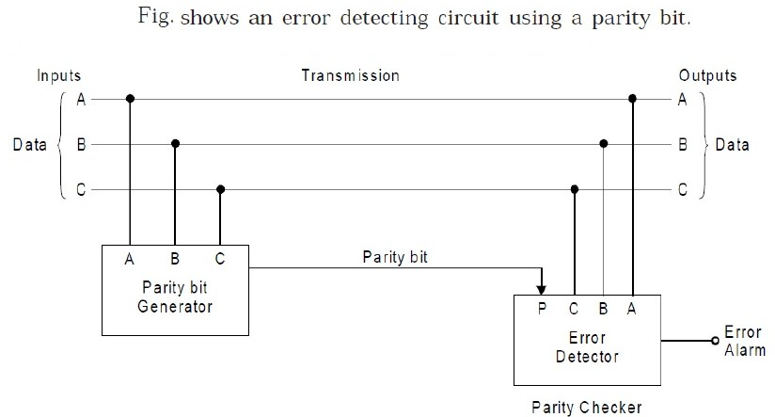

PARITY GENERATOR
141

Slide 116


PARITY GENERATOR
A table illustrates even parity as well as odd parity for a message consisting of three bits.
3-bit Message |  |  | Odd Party bit | Even Parity bit
A | B | C
0 | 0 | 0 | 1 | 0
0 | 0 | 1 | 0 | 1
0 | 1 | 0 | 0 | 1
0 | 1 | 1 | 1 | 0
1 | 0 | 0 | 0 | 1
1 | 0 | 1 | 1 | 0
1 | 1 | 0 | 1 | 0
1 | 1 | 1 | 0 | 1
Parity generator truth table for even and odd parity
141

Slide 117

PARITY GENERATOR
If the message bit combination is designated as A, B, C and P_{e}, P_{o} are the even and odd parity respectively, then it is obvious from table that the boolean expressions of even parity and odd parity are
P_{e} = (A ⊕ B ⊕ C) and P_{o} = (A ⊕ B ⊕ C)′
P_{e} = A’B’C+ A’BC’+ AB’C’+ ABC
= A’ (B’C+ BC’) + A (B’C’+ BC)
= A’ (B⊕C) + A (B⊕C)’
= (A ⊕ B ⊕ C)

Slide 118
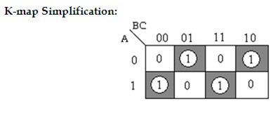
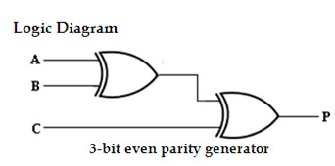

PARITY GENERATOR

Slide 119


PARITY CHECKER
The message bits with the parity bit are transmitted to their destination, where they are applied to a parity checker circuit. The circuit that checks the parity at the receiver side is called the parity checker.
The parity checker circuit produces a check bit and is very similar to the parity generator circuit. If the check bit is 1, then it is assumed that the received data is incorrect.
The check bit will be 0 if the received data is correct. The table shows the truth table for the even parity checker.

Slide 120


PARITY CHECKER
4-Bit Received |  |  |  | Parity Error Check (PEC)
A | B | C | P
0 | 0 | 0 | 0 | 0
0 | 0 | 0 | 1 | 1
0 | 0 | 1 | 0 | 1
0 | 0 | 1 | 1 | 0
0 | 1 | 0 | 0 | 1
0 | 1 | 0 | 1 | 0
0 | 1 | 1 | 0 | 0
0 | 1 | 1 | 1 | 1
1 | 0 | 0 | 0 | 1
1 | 0 | 0 | 1 | 0
1 | 0 | 1 | 0 | 0
1 | 0 | 1 | 1 | 1
1 | 1 | 0 | 0 | 0
1 | 1 | 0 | 1 | 1
1 | 1 | 1 | 0 | 1
1 | 1 | 1 | 1 | 0
Parity checker truth table for even parity

Slide 121


PARITY CHECKER

Slide 122


PARITY CHECKER

Slide 123
PARITY CHECKER
APPLICATIONS
Parity bit generator is used in digital communications where the messages are transmitted in the form of 1’s and 0’s.
The SCSI and PCI buses use parity to detect transmission errors, and many microprocessor instruction caches include parity protection.
In serial communication contexts, parity is usually generated and checked by interface hardware (e.g., a UART)
144

Slide 124




Slide 125


MULTIPLEXERS
A Multiplexer or MUX, is a combinational circuit with more than one input line, one output line and more than one selection line.
A multiplexer selects binary information present from one of many input lines, depending upon the logic status of the selection inputs, and routes it to the output line.
Normally, there are 2^{n} input lines and n selection lines whose bit combinations determine which input is selected. The multiplexer is often labeled as MUX in block diagrams.

Slide 126



MULTIPLEXERS
A multiplexer is also called a data selector, since it selects one of many inputs and steers the binary information to the output line.
Block diagram of Multiplexer

Slide 127

MULTIPLEXERS
2:1 MUX
The 2:1 multiplexer acts like an electronic switch that selects one of the two sources.
The circuit has two data input lines, one output line and one selection line, S.
When S= 0, the upper AND gate is enabled and I₀ has a path to the output.
When S=1, the lower AND gate is enabled and I₁ has a path to the output.

Slide 128



MULTIPLEXERS
2:1 MUX

Slide 129

MULTIPLEXERS
4:1 MUX
A 4-to-1-line multiplexer has four (2^{n}) input lines, two (n) select lines and one output line.
It is the multiplexer consisting of four input channels and information of one of the channels can be selected and transmitted to an output line according to the select inputs combinations.
Selection of one of the four input channel is possible by two selection inputs.

Slide 130


MULTIPLEXERS
4:1 MUX
Each of the four inputs I₀ through I₃, is applied to one input of AND gate. Selection lines S₁ and S₀ are decoded to select a particular AND gate.
The outputs of the AND gate are applied to a single OR gate that provides the 1-line output.
Truth table

Slide 131

MULTIPLEXERS
4:1 MUX
The data output is equal to I₀ only if S₁= 0 and S₀= 0; Y= I₀S₁’S₀’.
The data output is equal to I₁ only if S₁= 0 and S₀= 1; Y= I₁S₁’S₀. The data output is equal to I₂ only if S₁= 1 and S₀= 0; Y= I₂S₁S₀’.
The data output is equal to I₃ only if S₁= 1 and S₀= 1; Y= I₃S₁S₀.
When these terms are ORed, the total expression for the data output is,
Y= I₀S₁’S₀’+ I₁S₁’S₀ +I₂S₁S₀’+ I₃S₁S_{0.}
157

Slide 132


MULTIPLEXERS
4:1 MUX

Slide 133


MULTIPLEXERS
4:1 MUX
To demonstrate the circuit operation, consider the case when S₁S₀= 10.
The AND gate associated with input I₂ has two of its inputs equal to 1 and the third input connected to I₂.
The other three AND gates have at least one input equal to 0, which makes their outputs equal to 0.
The OR output is now equal to the value of I₂, providing a path from the selected input to the output.

Slide 134


MULTIPLEXERS
8:1 MUX

Slide 135

MULTIPLEXERS
MUX APPLICATIONS
Communication system –The efficiency of communication system can be increased considerably using multiplexer. Multiplexer allow the process of transmitting different type of data such as audio, video at the same time using a single transmission line.
Telephone network – In telephone network, multiple audio signals are integrated on a single line for transmission with the help of multiplexers. In this way, multiple audio signals can be isolated and eventually, the desire audio signals reach the intended recipients.
Transmission from the computer system of a satellite – Multiplexer can be used for the transmission of data signals from the computer system of a satellite or spacecraft to the ground system using the GPS (Global Positioning System) satellites.

Slide 136

MULTIPLEXERS
MULTIPLEXERS TREE
It is possible to expand the range of input for multiplexer beyond the available range in the integrated circuits.
This can be accomplished by interconnecting several multiplexers. For example two 8:1 mux can be used together to form a 16:1 mux and two 16:1 mux can be used to realize the 32:1 mux.
Even we can realize 32:1 mux can be realized with a smaller sized mux like 8:1 or 4:1 or 2:1 by properly assigning the selection lines to those mux circuits.
MODULE-3

Slide 137


MULTIPLEXERS
MULTIPLEXERS TREE
8:1 Mux using 4:1 & 2:1 MUX
MODULE-3

Slide 138


MULTIPLEXERS
MULTIPLEXERS TREE
Here, the number of selection lines require to implement 8:1 mux is 3 (S2,S1,S0). The select inputs S1 and S0 of both multiplexers provided to the selections lines of 4:1 mux i.e S1, S0. Whereas the S3 selection input of the second level 2:1 multiplexer is connected to S3 selection line.
So for S2 = 0, the upper multiplexer is selected and input lines d0 to d3 are selected according to the selected inputs and data is transmitted to an output through the OR gate. When S2 = 1, the lower multiplexer is activated and input lines d4 to d7 are selected according to the selected inputs.
MODULE-3

Slide 139


MULTIPLEXERS
MULTIPLEXERS TREE
16:1 Mux using 4:1 MUX
MODULE-3

Slide 140

MULTIPLEXERS
Implementation of boolean function using MUX
Implement the following boolean function
Example1:
using 8:1 mux, F (A, B, C) = ∑m (1, 3, 5, 6). Solution:
Variables, n= 3 (A, B, C) Select lines= 3 (S2, S₁, S₀)
Input lines = 2³ = 8 (D₀, D₁, D₂, D_{3,} D₄, D₅, D₆, D₇)
The three variables A, B, C are applied to the selection lines.
The minterms to be included (1, 3, 5 and 7) are chosen by making
their corresponding input lines equal to logic-1.
Minterms 0, 2, 4 and 7 are not included by making their input lines equal to logic-0.
MODULE-3

Slide 141


MULTIPLEXERS
Implementation of boolean function using MUX
MODULE-3

Slide 142

MULTIPLEXERS
Implementation of boolean function using MUX
Implement the following boolean function
Example2:
using 4:1 multiplexer, F (A, B, C) = ∑m (1, 3, 5, 6).
Solution:
Variables, n= 3 (A, B, C) Select lines= n-1 = 2 (S₁, S₀)
2^{n-1} to MUX i.e., 2² to 1 = 4 to 1 MUX Input lines= 2^{n-1} = 2² = 4 (D₀, D₁, D₂, D₃)
Implementation table:
Apply variables B and C to the select lines. The procedures for implementing the function are:
List the input of the multiplexer
List under them all the minterms in two rows as shown below.
MODULE-3

Slide 143

MULTIPLEXERS
Implementation of boolean function using MUX
The first half of the minterms is associated with A’ and the second half with A. The given function is implemented by encircling the minterms of the function and applying the following rules to find the values for the inputs of the multiplexer.
If both the minterms in the column are not circled, apply 0 to the corresponding input.
If both the minterms in the column are circled, apply 1 to the corresponding input.
If the bottom minterm is circled and the top is not circled, apply
A to the input.
If the top minterm is circled and the bottom is not circled, apply
A’ to the input.
MODULE-3

Slide 144




MULTIPLEXERS
Implementation of boolean function using MUX
Implementation table
Truth table
Mux implementation
MODULE-3

Slide 145



MULTIPLEXERS
Implementation of boolean function using MUX
MODULE-3

Slide 146


MULTIPLEXERS
Implementation of boolean function using MUX
MODULE-3

Slide 147


MODULE-3

Slide 148




DEMULTIPLEXERS
Demultiplexer means one into many. Demultiplexing is the process of taking information from one input and transmitting the same over one of several outputs.
A demultiplexer is a combinational logic circuit that receives information on a single input and transmits the same information over one of several (2^{n}) output lines.
MODULE-3

Slide 149

DEMULTIPLEXERS
The block diagram of a demultiplexer has one input signal, ‘n’ select signals and 2^{n} output signals.
The select inputs determine to which output the data input will be connected.
As the serial data is changed to parallel data, i.e., the input caused to appear on one of the n output lines, the demultiplexer is also called a “data distributer” or a “serial-to-parallel converter”.
MODULE-3

Slide 150


DEMULTIPLEXERS
1:4 DEMUX
A 1-to-4 demultiplexer has a single
input, D_{in}, four
outputs (Y₀ to Y₃) and two select inputs (S₁ and S₀).
The input variable D_{in} has a path to all four outputs, but the input information is directed to only one of the output lines.
MODULE-3

Slide 151



DEMULTIPLEXERS
1:4 DEMUX
^{D}in | S₁ | S₀ | Y₀ | Y₁ | Y₂ | Y₃
0 | 0 | 0 | 0 | 0 | 0 | 0
1 | 0 | 0 | 1 | 0 | 0 | 0
0 | 0 | 1 | 0 | 0 | 0 | 0
1 | 0 | 1 | 0 | 1 | 0 | 0
0 | 1 | 0 | 0 | 0 | 0 | 0
1 | 1 | 0 | 0 | 0 | 1 | 0
0 | 1 | 1 | 0 | 0 | 0 | 0
1 | 1 | 1 | 0 | 0 | 0 | 1
Truth table of 1-to-4 line Demultiplexer
MODULE-3

Slide 152

DEMULTIPLEXERS
1:4 DEMUX
From the truth table, it is clear that the data input, D_{in} is connected to the output Y₀, when S₁= 0 and S₀=0 and the data input is connected to output Y₁ when S₁=0 and S₀=1.
Similarly, the data input is connected to output Y₂ and Y₃ when S₁=1 and S₀=0 and when S₁=1 and S₀=1, respectively.
Also, from the truth table, the expression for outputs can be written as follows,
Y₀= S₁’S₀’D_{in} Y₁= S₁’S₀D_{in} Y₂= S₁S₀’D_{in} Y₃= S₁S₀D_{in}
MODULE-3

Slide 153


DEMULTIPLEXERS
1:4 DEMUX
Logic diagram of 1-to-4 line demultiplexer
MODULE-3

Slide 154

DEMULTIPLEXERS
1:4 DEMUX
Now, using the above expressions, a 1-to-4 line demultiplexer can be implemented using four 3-input AND gates and two NOT gates.
Here, the input data line D_{in}, is connected to all the AND gates.
The two select lines S₁, S₀ enable only one gate at a time and the data that appears on the input line passes through the selected gate to the associated output line.
MODULE-3

Slide 155

DEMULTIPLEXERS
1:8 DEMUX
A 1-to-8 line demultiplexer has a single input, D_{in}, eight outputs (Y₀ to Y₇) and three select inputs (S_{2,} S₁ and S₀). It
distributes one input line to eight output lines based on the select inputs.
^{D}in | S₂ | S₁ | S₀ | Y₇ | Y₆ | Y₅ | Y₄ | Y₃ | Y₂ | Y₁ | Y₀
0 | x | x | x | 0 | 0 | 0 | 0 | 0 | 0 | 0 | 0
1 | 0 | 0 | 0 | 0 | 0 | 0 | 0 | 0 | 0 | 0 | 1
1 | 0 | 0 | 1 | 0 | 0 | 0 | 0 | 0 | 0 | 1 | 0
1 | 0 | 1 | 0 | 0 | 0 | 0 | 0 | 0 | 1 | 0 | 0
1 | 0 | 1 | 1 | 0 | 0 | 0 | 0 | 1 | 0 | 0 | 0
1 | 1 | 0 | 0 | 0 | 0 | 0 | 1 | 0 | 0 | 0 | 0
1 | 1 | 0 | 1 | 0 | 0 | 1 | 0 | 0 | 0 | 0 | 0
1 | 1 | 1 | 0 | 0 | 1 | 0 | 0 | 0 | 0 | 0 | 0
1 | 1 | 1 | 1 | 1 | 0 | 0 | 0 | 0 | 0 | 0 | 0
MODULE-3

Slide 156

DEMULTIPLEXERS
1:8 DEMUX
From the above truth table, it is clear that the data input is connected with one of the eight outputs based on the select inputs.
Now from this truth table, the expression for eight outputs can be written as follows:
Y₀= S₂’S₁’S₀’D_{in} Y₁= S₂’S₁’S₀D_{in} Y₂= S₂’S₁S₀’D_{in} Y₃= S₂’S₁S₀D_{in}
Y₄= S₂ S₁’S₀’D_{in} Y₅= S₂ S₁’S₀D_{in} Y₆= S₂ S₁S₀’D_{in} Y₇= S₂S₁S₀D_{in}
MODULE-3

Slide 157

DEMULTIPLEXERS
1:8 DEMUX
Now using the above expressions, the logic diagram of a 1-to-8 demultiplexer can be drawn as shown.
Here, the single data line, D_{in} is connected to all the eight AND gates, but only one of the eight AND gates will be enabled by the select input lines.
For example, if S₂S₁S₀= 000, then only AND gate-0 will be enabled and thereby the data input, D_{in} will appear at Y₀. Similarly, the different combinations of the select inputs, the input D_{in} will appear at the respective output.
MODULE-3

Slide 158


DEMULTIPLEXERS
1:8 DEMUX
MODULE-3

Slide 159


DEMULTIPLEXERS
DEMULTIPLEXERS TREE
Example: Design 1:8 demultiplexer using 1:4 & 1:2 DEMUX.
MODULE-3

Slide 160


DEMULTIPLEXERS
IMPLEMENTATION OF BOOLEAN EXPRESSION USING DEMUX
Example1: Implement the following boolean function using 1:8 Demux. F (A, B, C) = ∑m (1, 3, 5, 6).
Inputs |  |  | Outputs
A | B | C | Y
0 | 0 | 0 | 0
0 | 0 | 1 | 1
0 | 1 | 0 | 0
0 | 1 | 1 | 1
1 | 0 | 0 | 0
1 | 0 | 1 | 1
1 | 1 | 0 | 1
1 | 1 | 1 | 0
MODULE-3

Slide 161


DEMULTIPLEXERS
IMPLEMENTATION OF BOOLEAN EXPRESSION USING DEMUX
MODULE-3

Slide 162



DEMULTIPLEXERS
IMPLEMENTATION OF BOOLEAN EXPRESSION USING DEMUX
Example2: Implement full subtractor using demux
Inputs |  |  | Outputs
A | B | ^{B}in | Difference(D) | Borrow(B_{out})
0 | 0 | 0 | 0 | 0
0 | 0 | 1 | 1 | 1
0 | 1 | 0 | 1 | 1
0 | 1 | 1 | 0 | 1
1 | 0 | 0 | 1 | 0
1 | 0 | 1 | 0 | 0
1 | 1 | 0 | 0 | 0
1 | 1 | 1 | 1 | 1
MODULE-3

Slide 163


DEMULTIPLEXERS
IMPLEMENTATION OF BOOLEAN EXPRESSION USING DEMUX
Full Subtractor using 1:8 demux
MODULE-3

Slide 164



